Slide 1
SURVEY APPLICATION

Slide 2
DESCRIPTION
User Authentication: Users log into the app using their credentials, ensuring that survey responses are tied to verified individuals and that access to surveys is secure and managed.
Survey Downloading: The app connects to a server to download available questionnaires, which are saved locally on the device for easy offline access. This allows users to fill out surveys even when they don't have a network connection.
Survey Browsing: Users can view a list of all downloaded surveys within the app. This list shows the available surveys in an organized manner, allowing users to easily browse and choose a survey they wish to complete.
Survey Selection: After browsing, users can select a specific survey to view its details and proceed to start filling it out. This intuitive selection process ensures that users can navigate through the app smoothly and pick the right survey without hassle.
Survey Completion Interface: The survey interface supports multiple question types, including multiple-choice, text input, rating scales, and checkboxes.
Automatic Syncing of Responses: The app is designed to automatically sync completed survey responses with the server every 15 minutes, provided a network connection is available. This regular syncing ensures that data remains up-to-date without requiring manual uploads from the user.

Slide 3
Main Activity.java:
import android.os.Bundle
import androidx.activity.compose.setContent
import androidx.appcompat.app.AppCompatActivity
import androidx.compose.foundation.layout.fillMaxSize
import androidx.compose.material3.MaterialTheme
import androidx.compose.material3.Surface
import androidx.compose.ui.Modifier
import androidx.core.view.WindowCompat
import com.manasmalla.jetsurvey.ui.JetsurveyApp
import com.manasmalla.jetsurvey.ui.theme.JetsurveyTheme
class MainActivity : AppCompatActivity() {
override fun onCreate(savedInstanceState: Bundle?) {
super.onCreate(savedInstanceState)
setContent {
WindowCompat.setDecorFitsSystemWindows(window, false)
JetsurveyTheme {
// A surface container using the 'background' color from the theme
Surface(
modifier = Modifier.fillMaxSize(),
color = MaterialTheme.colorScheme.background
) {
JetsurveyApp()} }}}}

Slide 4
Sign-in Screen.kt
import androidx.compose.foundation.layout.Column
import androidx.compose.foundation.layout.fillMaxWidth
import androidx.compose.foundation.layout.padding
import androidx.compose.foundation.text.KeyboardActions
import androidx.compose.foundation.text.KeyboardOptions
import androidx.compose.material.icons.Icons
import androidx.compose.material.icons.rounded.ChevronLeft
import androidx.compose.material.icons.rounded.Visibility
import androidx.compose.material.icons.rounded.VisibilityOff
import androidx.compose.material3.Button
import androidx.compose.material3.CenterAlignedTopAppBar
import androidx.compose.material3.ExperimentalMaterial3Api
import androidx.compose.material3.Icon
import androidx.compose.material3.IconButton
import androidx.compose.material3.MaterialTheme
import androidx.compose.material3.OutlinedButton
import androidx.compose.material3.OutlinedTextField
import androidx.compose.material3.Scaffold
import androidx.compose.material3.SnackbarHostState
import androidx.compose.material3.Text
import androidx.compose.material3.TextButton
import androidx.compose.runtime.Composable
import androidx.compose.runtime.derivedStateOf

Slide 5
import androidx.compose.runtime.getValue
import androidx.compose.runtime.mutableStateOf
import androidx.compose.runtime.remember
import androidx.compose.runtime.rememberCoroutineScope
import androidx.compose.runtime.saveable.rememberSaveable
import androidx.compose.runtime.setValue
import androidx.compose.ui.Alignment
import androidx.compose.ui.Modifier
import androidx.compose.ui.res.stringResource
import androidx.compose.ui.text.input.ImeAction
import androidx.compose.ui.text.input.PasswordVisualTransformation
import androidx.compose.ui.text.input.VisualTransformation
import androidx.compose.ui.tooling.preview.Preview
import androidx.compose.ui.unit.dp
import com.manasmalla.jetsurvey.R
import com.manasmalla.jetsurvey.ui.survey.util.ErrorSnackbar
import com.manasmalla.jetsurvey.ui.theme.JetsurveyTheme
import kotlinx.coroutines.launch

Slide 6
@OptIn(ExperimentalMaterial3Api::class)
@Composable
fun SignInScreen(
startingEmail: String? = null,
onNavigateBack: () -> Unit = {},
onNavigateToSurvey: () -> Unit = {}
) {
var email by remember {
mutableStateOf(startingEmail ?: "")
}
var password by remember {
mutableStateOf("")
}
var isPasswordVisible by rememberSaveable {
mutableStateOf(false)
}
val isFormStateValid by remember {
derivedStateOf { password != "" && email != "" }
}
val scope = rememberCoroutineScope()
val snackbarErrorText = stringResource(id = R.string.feature_not_available)
val snackbarActionLabel = stringResource(id = R.string.dismiss)
val snackbarHost = remember { SnackbarHostState() }

Slide 7
Scaffold(topBar = {
CenterAlignedTopAppBar(title = {
Text(text = "Sign In")
}, navigationIcon = {
IconButton(onClick = onNavigateBack) {
Icon(
Icons.Rounded.ChevronLeft,
contentDescription = null,
tint = MaterialTheme.colorScheme.primary
)
}
})
}, snackbarHost = {
ErrorSnackbar(snackbarHostState = snackbarHost, onDismiss = {
snackbarHost.currentSnackbarData?.dismiss()
})
}, containerColor = MaterialTheme.colorScheme.background) {
Column(
modifier = Modifier
.padding(it)
.padding(horizontal = 24.dp),
horizontalAlignment = Alignment.CenterHorizontally
) {

Slide 8
OutlinedTextField(
value = email,
onValueChange = { userEmail ->
email = userEmail
},
placeholder = {
Text("Email")
},
singleLine = true,
modifier = Modifier
.fillMaxWidth()
.padding(top = 36.dp),
shape = MaterialTheme.shapes.small
)
OutlinedTextField(value = password,
shape = MaterialTheme.shapes.small,
onValueChange = { userPassword ->
password = userPassword
},
singleLine = true,
keyboardActions = KeyboardActions(onDone = {
// Keyboard Actions
}),
keyboardOptions = KeyboardOptions.Default.copy(imeAction = ImeAction.Done),

Slide 9
placeholder = {
Text("Password")
},
modifier = Modifier
.fillMaxWidth()
.padding(vertical = 24.dp),
visualTransformation = if (isPasswordVisible) VisualTransformation.None else PasswordVisualTransformation(),
trailingIcon = {
IconButton(onClick = { isPasswordVisible = !isPasswordVisible }) {
Icon(
if (!isPasswordVisible) Icons.Rounded.VisibilityOff else Icons.Rounded.Visibility,
contentDescription = if (!isPasswordVisible) "Hide Password" else "View Password"
)
}
})
Button(
onClick = {
onNavigateToSurvey()
}, modifier = Modifier
.fillMaxWidth()
.padding(vertical = 24.dp), enabled = isFormStateValid
) {
Text("Sign in") }

Slide 10
TextButton(
onClick = {
scope.launch {
snackbarHost.showSnackbar(snackbarErrorText, snackbarActionLabel)
}
}, modifier = Modifier
.fillMaxWidth()
.padding(vertical = 24.dp)
) {
Text("Forgot Password?")}
Text(text = "or")
OutlinedButton(
onClick = onNavigateToSurvey, modifier = Modifier
.fillMaxWidth()
.padding(vertical = 24.dp)
) {
Text("Sign in as a guest")}}}}
@Preview
@Composable
fun SignInScreenPreview() {
JetsurveyTheme {
SignInScreen()
}
}

Slide 11
WelcomeScreen.kt
import androidx.compose.foundation.Image
import androidx.compose.foundation.layout.Column
import androidx.compose.foundation.layout.fillMaxWidth
import androidx.compose.foundation.layout.padding
import androidx.compose.foundation.layout.wrapContentHeight
import androidx.compose.foundation.text.KeyboardActions
import androidx.compose.foundation.text.KeyboardOptions
import androidx.compose.material3.Button
import androidx.compose.material3.ExperimentalMaterial3Api
import androidx.compose.material3.MaterialTheme
import androidx.compose.material3.OutlinedButton
import androidx.compose.material3.OutlinedTextField
import androidx.compose.material3.Text
import androidx.compose.runtime.Composable
import androidx.compose.runtime.derivedStateOf
import androidx.compose.runtime.getValue
import androidx.compose.runtime.mutableStateOf
import androidx.compose.runtime.remember
import androidx.compose.runtime.setValue
import androidx.compose.ui.Alignment
import androidx.compose.ui.Modifier
import androidx.compose.ui.res.painterResource

Slide 12
import androidx.compose.ui.text.input.ImeAction
import androidx.compose.ui.tooling.preview.Preview
import androidx.compose.ui.unit.dp
import com.manasmalla.jetsurvey.R
@Preview
@Composable
fun Title(modifier: Modifier = Modifier) {
Column(
modifier = modifier.fillMaxWidth(), horizontalAlignment = Alignment.CenterHorizontally
) {
Image(
painter = painterResource(id = R.drawable.ic_logo_light),
contentDescription = "Jetsurvey“)
Text(
text = "Better surveys with Jetpack Compose",
style = MaterialTheme.typography.bodyMedium,
modifier = Modifier.padding(vertical = 16.dp))}}
@OptIn(ExperimentalMaterial3Api::class)
@Preview
@Composable
fun SignInSection(modifier: Modifier = Modifier, onNavigateToSignIn: (String) -> Unit = {}, onNavigateToSurvey: () -> Unit = {}) {
var email by remember {
mutableStateOf("")}

Slide 13
val isButtonEnabled by remember {
derivedStateOf {
email != ""
}
}
Column(modifier = modifier, horizontalAlignment = Alignment.CenterHorizontally) {
Text(text = "Sign in or create an account", modifier = Modifier.padding(vertical = 16.dp))
OutlinedTextField(
value = email,
onValueChange = {
email = it
},
placeholder = {
Text("Email")
},
modifier = Modifier.fillMaxWidth(),
keyboardActions = KeyboardActions(onDone = {
if (isButtonEnabled) {
onNavigateToSignIn(email)
}
}),
keyboardOptions = KeyboardOptions.Default.copy(imeAction = ImeAction.Done),
singleLine = true,
shape = MaterialTheme.shapes.small
)

Slide 14
Button(
onClick = {
if (isButtonEnabled) {
onNavigateToSignIn(email)
}
}, modifier = Modifier
.fillMaxWidth()
.padding(vertical = 24.dp), enabled = isButtonEnabled
) {
Text("Continue")
}
Text(text = "or")
OutlinedButton(
onClick = onNavigateToSurvey, modifier = Modifier
.fillMaxWidth()
.padding(vertical = 24.dp)
) {
Text("Sign in as a guest")
}
}
}

Slide 15
@Preview(showBackground = true)
@Composable
fun WelcomeScreen(onNavigateToSignIn: (String) -> Unit = {}, onNavigateToSurvey: () -> Unit = {}) {
Column(
modifier = Modifier
.fillMaxWidth()
.padding(24.dp)
) {
Title(
Modifier
.weight(1f)
.wrapContentHeight(Alignment.CenterVertically)
)
SignInSection(onNavigateToSignIn = onNavigateToSignIn, onNavigateToSurvey = onNavigateToSurvey)
}
}

Slide 16
Activity_main.xml:
<?xml version="1.0" encoding="utf-8"?>
<manifest xmlns:android="http://schemas.android.com/apk/res/android"
xmlns:tools="http://schemas.android.com/tools">
<application
android:allowBackup="true"
android:dataExtractionRules="@xml/data_extraction_rules"
android:fullBackupContent="@xml/backup_rules"
android:icon="@mipmap/ic_launcher"
android:label="@string/app_name"
android:roundIcon="@mipmap/ic_launcher_round"
android:supportsRtl="true"
android:theme="@style/Theme.Jetsurvey"
tools:targetApi="31">
<activity
android:name=".MainActivity"
android:exported="true"
android:label="@string/app_name"
android:theme="@style/Theme.Jetsurvey">
<intent-filter>
<action android:name="android.intent.action.MAIN" />

Slide 17
<category android:name="android.intent.category.LAUNCHER" />
</intent-filter>
</activity>
<provider
android:name="androidx.core.content.FileProvider"
android:authorities="${applicationId}.fileprovider"
android:grantUriPermissions="true"
android:exported="false">
<meta-data
android:name="android.support.FILE_PROVIDER_PATHS"
android:resource="@xml/filepaths" />
</provider>
</application>
</manifest>

Slide 18
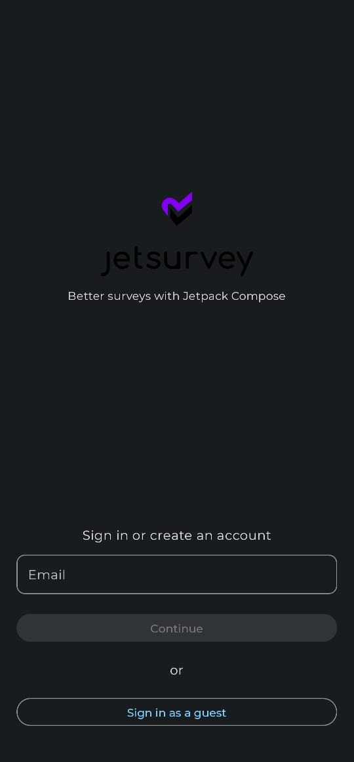
OUTPUT:

Slide 19
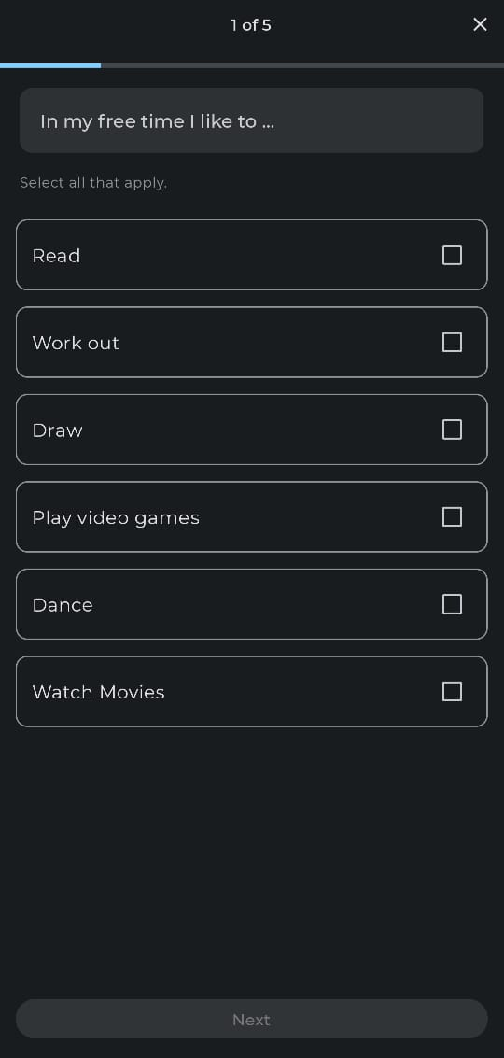

Slide 20
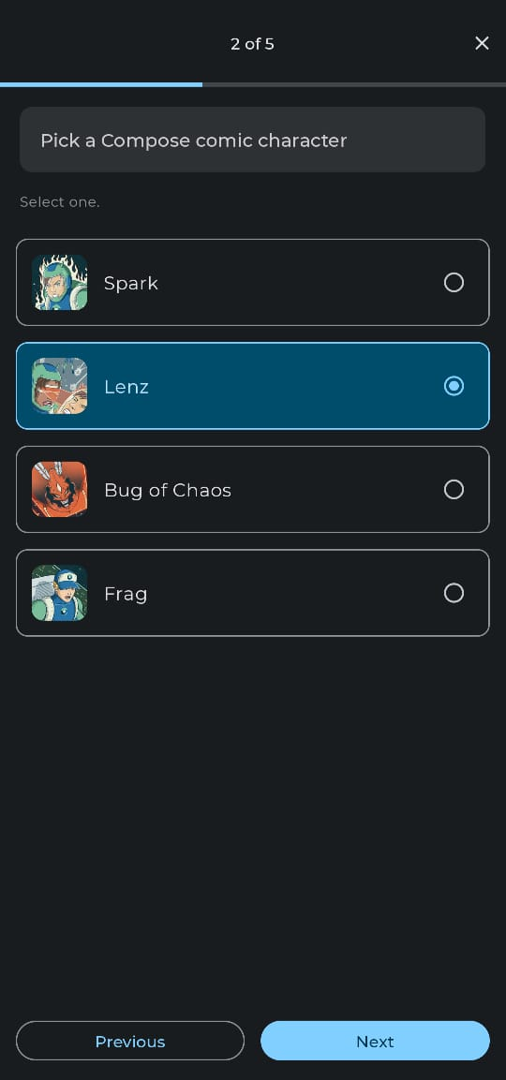

Slide 21
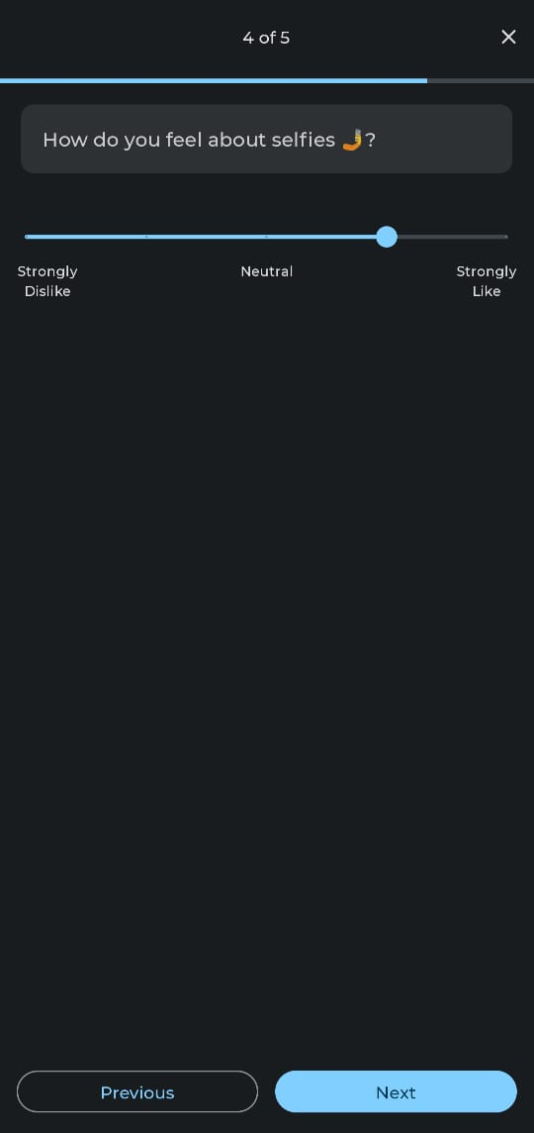

Slide 22
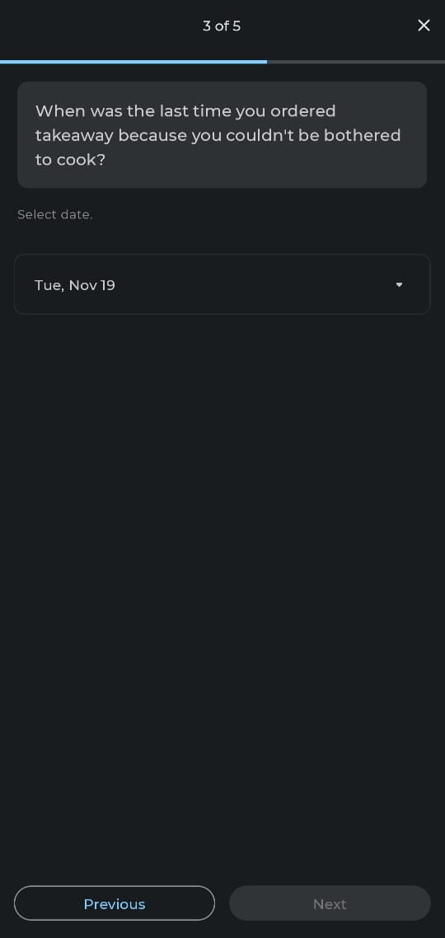

Slide 23
